Slide 1
Bike Anti-Theft Device
Presented by: Shreyas u
Guided by: Ass.Prof Mr.Prakash.M

Slide 2
Introduction:
The “Bike anti-theft device” is a system designed to protect bikes from being stolen. Bike theft system focuses on two wheelers so that if anyone tries to steal your bike, you are get notified and lets others to know by making loud noise .
The project proposes the design of a low cost anti-theft for bikes security based on detection of movement and vibration. In the current system, the vibration sensor and accelerometer sensor is used as a main sensor.
There are number of alarm system in the market that are very sensitive which makes many false alarms. False alarm occurs if anyone touches the bike or move the bike, the alarm triggers easily even though they do not have much sense of stealing. So by using bike anti-theft detectors will reduce false alarms.

Slide 3
Statement of problem:
Cars have better security systems than bikes such as GPS tracking, send real time alerts, theft detection and ability to shutdown engines remotely.
Once a bike gets stolen, users need to go through the filing an FIR and collecting the required document from the police station to prove the theft and make a claim against insurance.
Through this project i implement some similar functionalities to bikes. With such a security system user is able to prevent bikes from being stolen.

Slide 4
Motivation:
System like this are implemented for a long time. Beside from cars, such systems are never implemented on bikes. Due to this bike have become easier target for thieves to steal.
Therefore project proposed for providing security system for bike that prevent them from theft. Such a security system can be placed on any kinds of bikes by providing power through external battery.

Slide 5
Benefits and Challenges:
Benefits :
Improved Security: A bike anti-theft device can provide an extra layer of security and deter potential thieves from attempting to steal your bike.
Peace of Mind: With a bike anti-theft device, you can have peace of mind knowing that your bike is protected even when you're not around.
Reduced Costs: Investing in a bike anti-theft device can help you avoid the costly expense of replacing a stolen bike

Slide 6
Challenges:
Power Dependency.
System is not water resistant.
Maintenance.

Slide 7
Literature Overview:
Manjesh N etal the authors have The proposed model for Accident prevention uses RF technology to check if the rider is drunk and wearing a helmet, and starts the two-wheeler. A pressure sensor detects if the helmet is being worn and activates the vehicle. In case of an accident, a vibration sensor sends a message to the microcontroller, which communicates and sends Alert notification to a mobile number. The hardware used includes a microcontroller, vibration sensor, pressure sensor, RF sensor.
Krutika Naidu etal in this the author’s tell about how to make two-wheelers secure from theft. The project aims to secure two-wheelers from theft by using a fingerprint biometric module to authenticate the rider, and alerting the surroundings and owner via a buzzer and text message in case of theft. Which sends text message to the mobile devices by using microcontroller. The hardware used includes a microcontroller, fingerprint biometric module and buzzer.

Slide 8
Sudharsana Vijayan etal in this paper the authors propose a system aims to prevent bike theft by utilizing an Arduino Uno microcontroller and a vibration sensor. Whenever an intruder attempts to steal a bike, the vibration caused by their actions is detected by the sensor and transmitted to the microcontroller. The microcontroller then triggers a flashing LED and generates an alert to notify the surrounding area. Hardware used includes microcontroller, vibration sensor and LED.

Slide 9
S/w and h/w requirements:
Software requirements:
Arduino IDE.
Hardware components:
Nodemcu ESP8266.
Vibration sensor sw-18010p.
Accelerometer adxl335.
Buzzer.
LED.
Jumper wires & Breadboard.

Slide 10
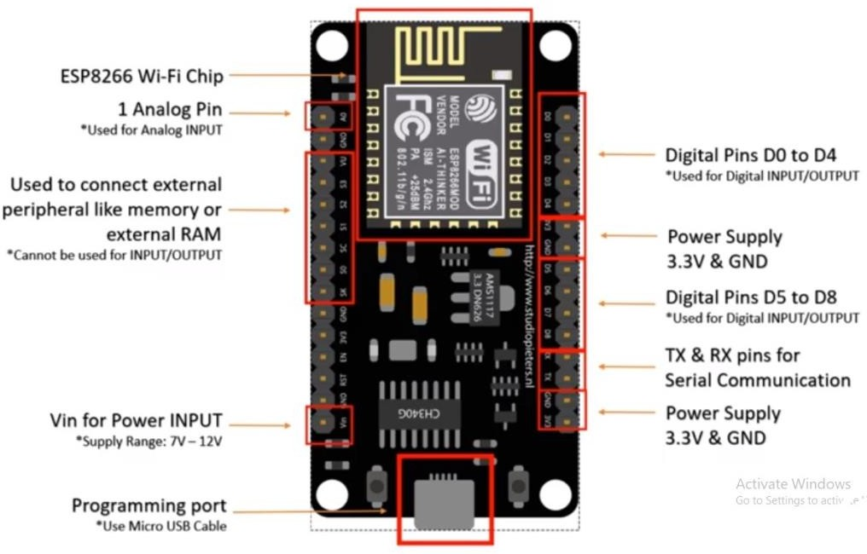
Components:
Nodemcu Esp8266:
Nodemcu esp8266 Wi-Fi module is an open-source, low-cost, low- power MCU (microcontroller unit) development board. It has 17 GPIO pins (11 are Digital I/O pins), out of which one pin is an analog pin, 4 pins support PWM, 2 pairs are for UART (UART0 and UART1).
Here ESP8266 microcontroller board is programmed to continuously monitor the vibration and moment sensors attached to it.

Slide 11
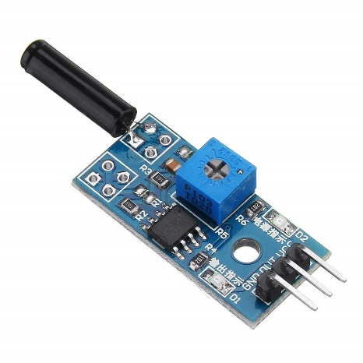
Vibration sensor:
The SW-18010P sensor is used to detect vibration. The sensor has a small spring inside a metal tube. When the sensor vibrates, the spring hits the metal tube and the sensor will be activated.
This sensor has digital output. When the sensor vibrates, the digital output changes from HIGH to LOW.
This Module has 3 pins:
VCC: Module power supply – 5V to 7V
GND: Ground
D0: Digital Output

Slide 12
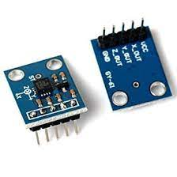
Accelerometer sensor:
The ADXL335 is a 3-axis accelerometer sensor that can measure acceleration in any direction, and it has three output pins - Xout, Yout, and Zout - that provide analog voltage signals proportional to the acceleration in the respective directions.
This Module has 5 pins:
VCC: Module power supply – 3.3V.
GND: Ground
Xout: Analog O/P
Yout: Analog O/P.
Zout: Analog O/P.

Slide 13
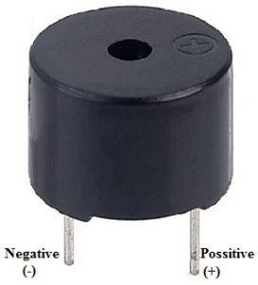
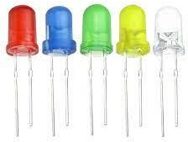
Buzzer:
An audio signalling device like a beeper or buzzer may be electromechanical or piezoelectric or mechanical type. The main function of this is to convert the signal from audio to sound.
LED:
A light-emitting diode (LED) is a semiconductor light source that emits light when current flows through it.

Slide 14
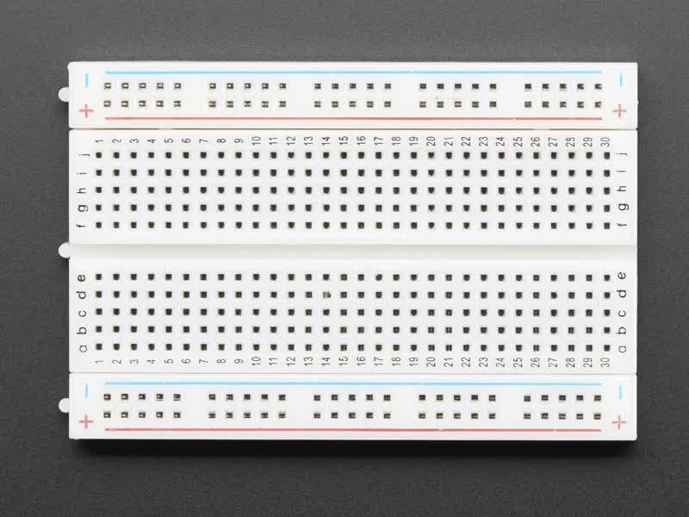
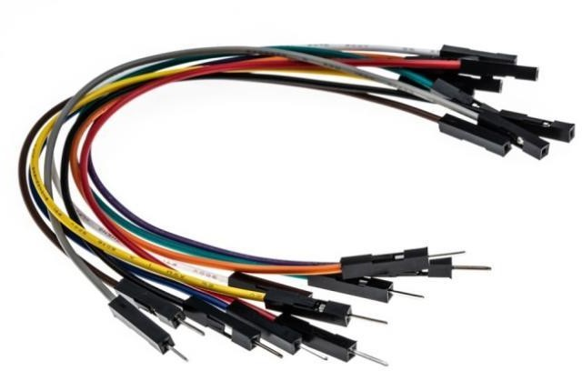
Breadboard
A breadboard is a solder less construction base used for developing an electronic circuit and wiring for projects with microcontroller boards like Arduino.
Jumper Wires
A jump wire is an electrical wire, or group of them in a cable, with a connector or pin at each end which is normally used to interconnect the components of a breadboard without soldering.

Slide 15
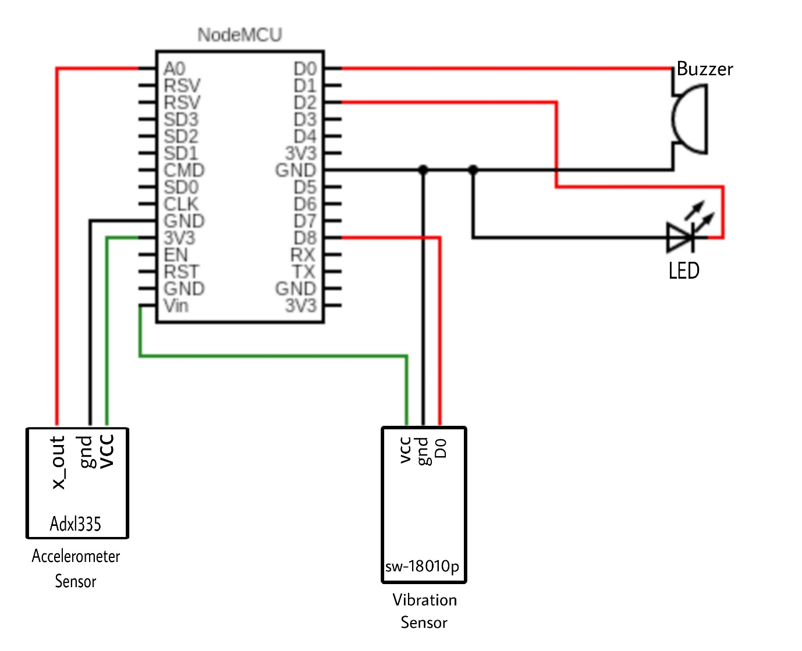
Circuit diagram:

Slide 16
Proposed method:
This proposed system is bike Anti-theft device uses an ESP8266 microcontroller board, various sensors, and the Telegram messaging platform to detect and alert the user of any unauthorized access to their vehicles. The system is designed to detect two types of events: vibration and movement.
The ESP8266 microcontroller board is programmed to continuously monitor the vibration and moment sensors attached to it. If a vibration is detected, it checks whether it is a false alarm by reading the sensor again. If the vibration persists, the board triggers an alarm by flashing the LED and buzzing the buzzer three times and sends an alert message to the user via the Telegram bot.

Slide 17
If the moment sensor detects any movement, the board triggers an alarm by flashing the LED and buzzing the buzzer and sends an alert message to the user via the Telegram bot. The user can also remotely activate or deactivate the alarm system using the Telegram bot by sending commands /activate or /deactivate.
The project requires an internet connection and a Telegram account to receive alerts. To enable the system to communicate with the Telegram bot, the program includes the Universal Telegram Bot library, which provides functions to send and receive messages from Telegram. The program also uses the Wi-Fi Client Secure library to establish a secure SSL connection to the Telegram server.
.

Slide 18
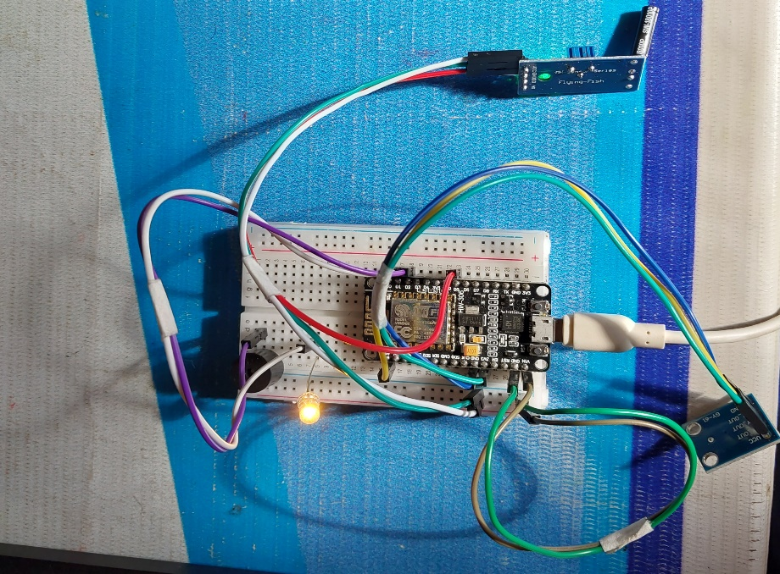
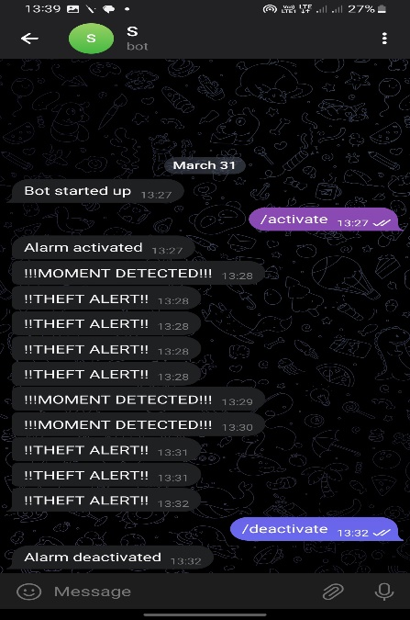
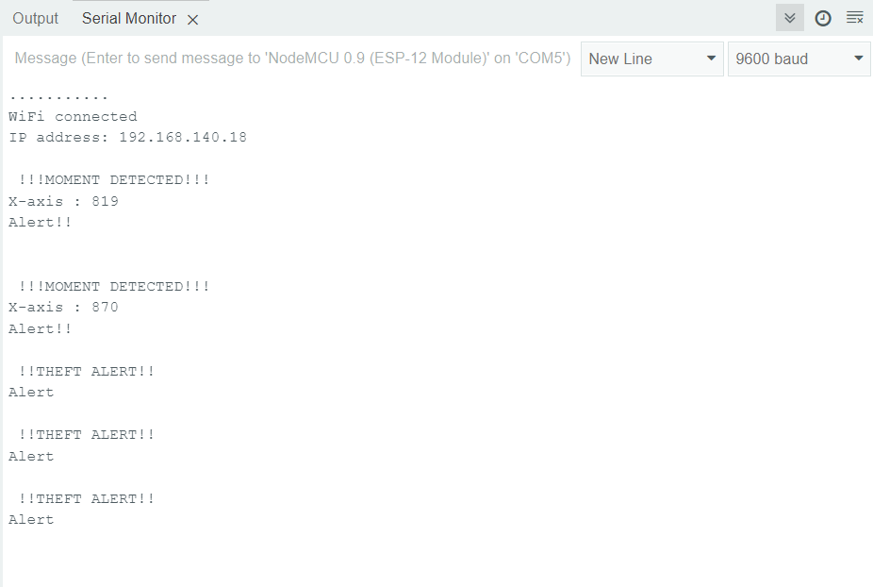
Output:
1.Working of project
2.Telegram bot message
3.Serial monitor

Slide 19
Conclusion:
Our proposed bike anti-theft device System is the advanced and reliable version of security mechanism for two wheeler vehicles. The proposed security system help to detect the bike theft which reduce the users to go through inconvenience.
Proposed bike theft detector can be installed on two wheeler vehicle of any class or company, thereby creating a huge market for the product. Small size of the module allows it to be placed under the seat of the vehicle, there by needing no physical changes to be done to the vehicle.
By installing our bike anti-theft device we can prevent the frequency of bike thefts encountered.

Slide 20
Future scope:
There are some potential future scope improvements for this bike anti-theft device project:
Adding GPS: Adding a GPS module to the system can help locate the bike if it is stolen. The system can send the current location of the bike to the owner's phone or email.
Cloud storage: Storing the data collected by the system in a cloud server can help with data analysis, which used to improve the system's accuracy in detecting theft.
Machine learning: Machine learning algorithms can help improve the accuracy of the system in detecting bike theft and reduce the number of false alarms.
Mobile app integration: Developing a mobile app for the anti-theft system can provide a more user-friendly interface for the owner to monitor their bike's security status and receive alerts in real-time.

Slide 21
Thank you

